Slide 1

ITC 6000 Database Management Systems Final Project Presentation 2024 Fall B Nutrition and Wellness Tracking
Satya Sai Srinivas Yendru
yendru.s@northeastern.edu

Slide 2
Project Overview
Title: Nutrition and Wellness Tracking Application
Purpose: Empower users to maintain healthy lifestyles by tracking dietary intake, exercise routines, and wellness goals.
Business Model: Freemium model offering free basic features and subscription-based advanced analytics and coach recommendations.
Key Features:
Daily tracking for food, water, and exercise
Personalized insights and progress monitoring
Coach-driven recommendations

Slide 3
Personas
End-Users
Potentially millions of users. As an End-User, I want to:
Track my daily nutrition, exercise, and water intake.
Set personal wellness goals and monitor my progress.
Receive personalized recommendations for diet and exercise.
Nutrition Coaches
Potentially thousands of coaches. As a Coach, I want to:
Access client logs to provide tailored advice.
Use analytics tools to understand client habits.
Share wellness recommendations and track adherence.
Administrators
A dozen or two back-end admins. Administrators need to:
Ensure data security and system performance.
Monitor and resolve any technical issues.
Manage and enforce policies for users and coaches.

Slide 4
Business Rules
Registration: Secure user authentication with unique credentials.
Daily Logs: Timestamped entries for food, water, and exercise.
Goal Setting: Tracks metrics like weight and calorie burn.
Access Control: Role-based access for users, coaches, and admins.
Data Integrity: Enforced relationships via foreign keys and indexed fields.

Slide 5
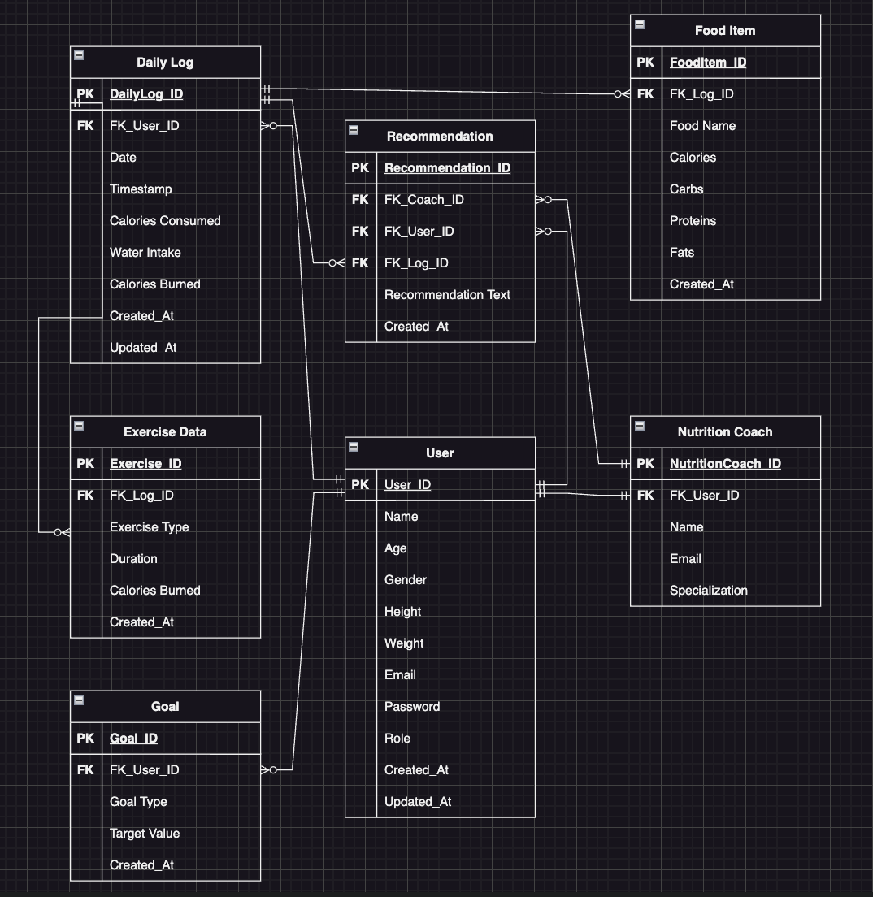
ERD Diagram
Entities:
User, Nutrition Coach, Daily Log, Food Item, Exercise Data, Goal, Recommendation.

Slide 6
Solution Architecture
Database Architecture Requirements
Client/Server Architecture:
The app uses a two-tier architecture, where the client (frontend app) communicates directly with the SQLite database as a lightweight backend.
Cloud Hosting:
The database is not cloud-hosted in this scenario but can be hosted on cloud platforms like AWS RDS or Azure for scalability and global accessibility.
Storage Requirements:
SQLite is sufficient for lightweight applications. For larger datasets or concurrent user access, transitioning to a relational database like MySQL or PostgreSQL is recommended.

Slide 7
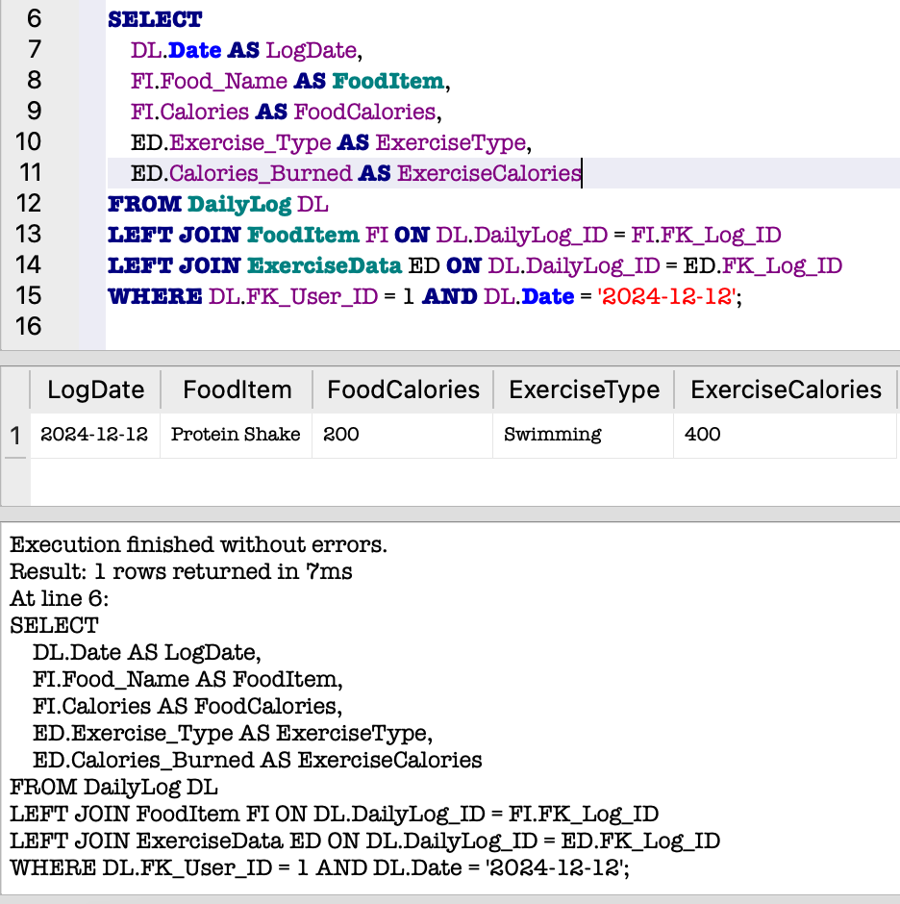
SQL Example1
Query: Retrieve Comprehensive Daily Log for a User

Slide 8
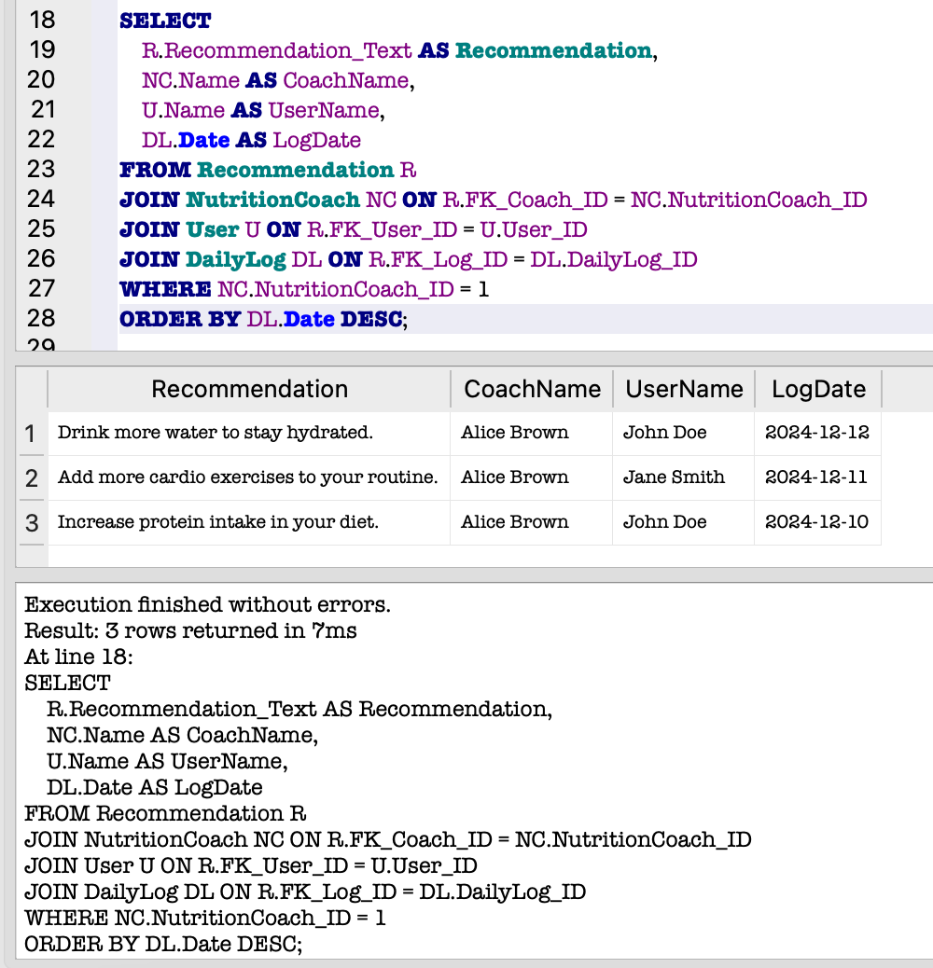
SQL Example2
Query: Fetch Recommendations by a Coach

Slide 9
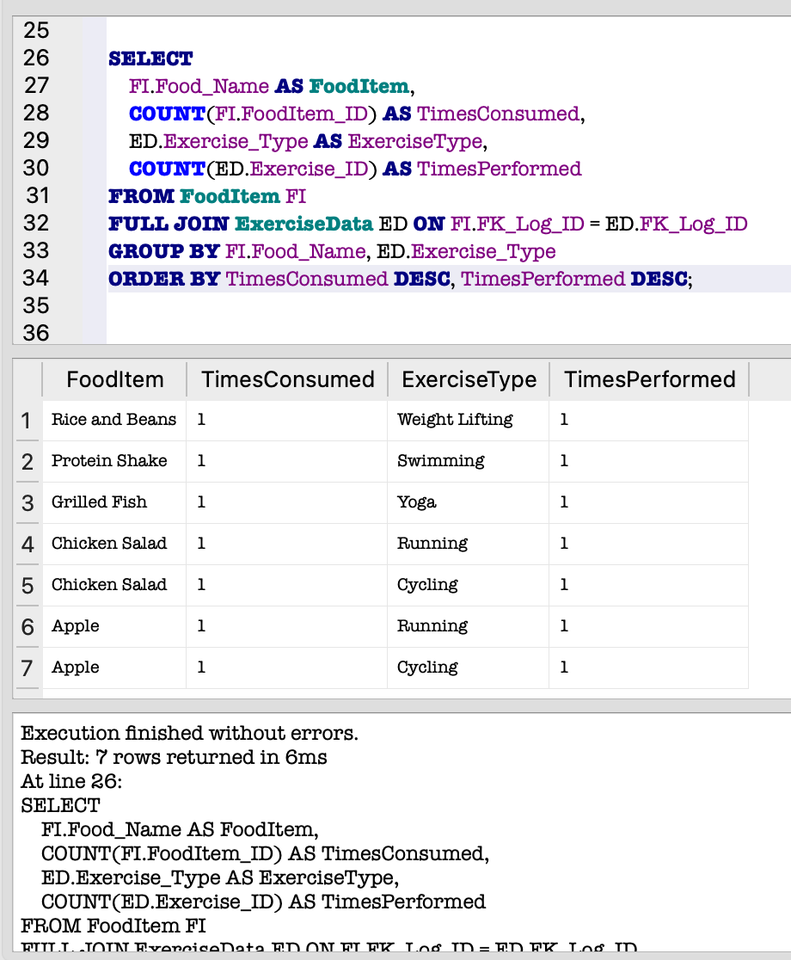
Analytics and Metrics
Query1: Popular Food Items and Exercises

Slide 10
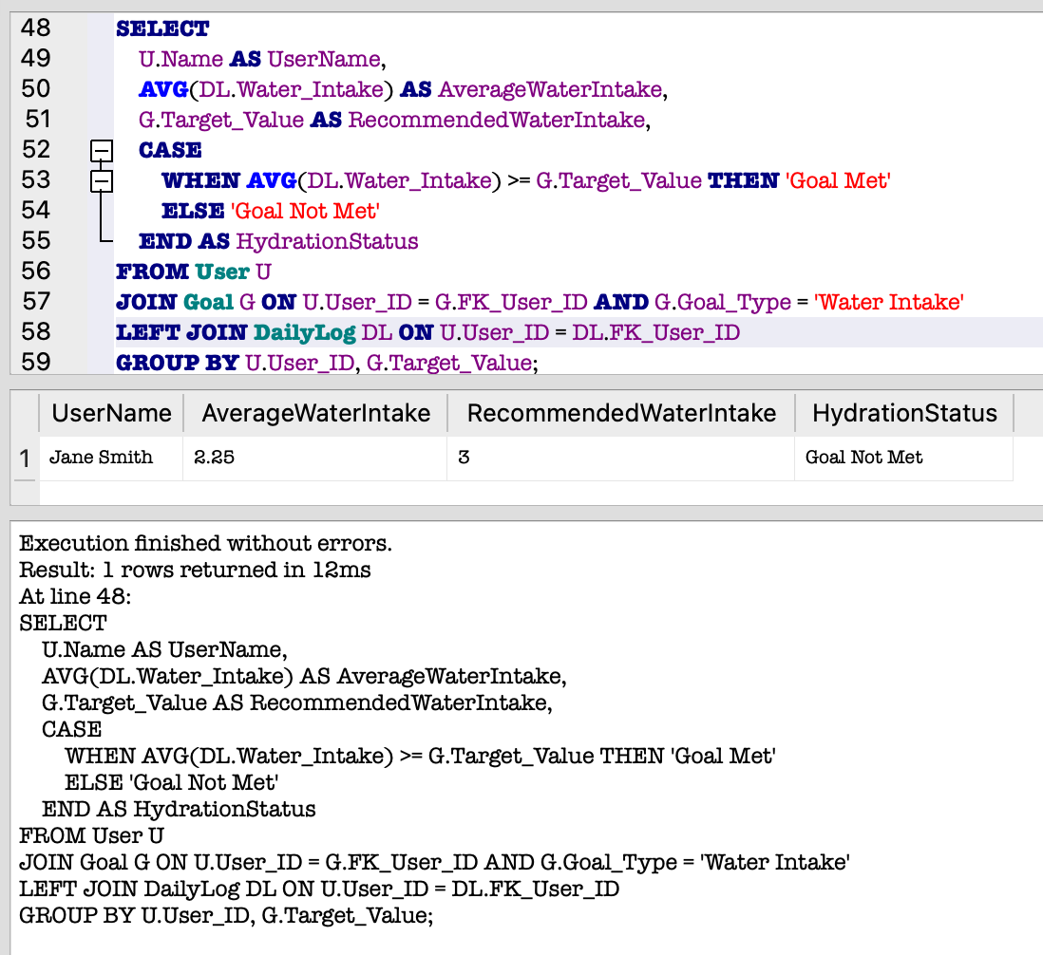
Analytics and Metrics
Query2: Water Intake Report

Slide 11
Security Concerns
The primary security concerns include:
User Data Privacy: Protecting sensitive personal data like email and weight.
Role-Based Access Control (RBAC): Ensuring coaches and admins have limited access to data.
SQL Injection Prevention: Using parameterized queries to avoid database attacks.

Slide 12
Future Considerations
Future Enhancements:
Integration with wearables for real-time tracking.
Integrating machine learning for predictive analytics.

